Slide 1
B Trees
Adeem Ali Anwar

Slide 2
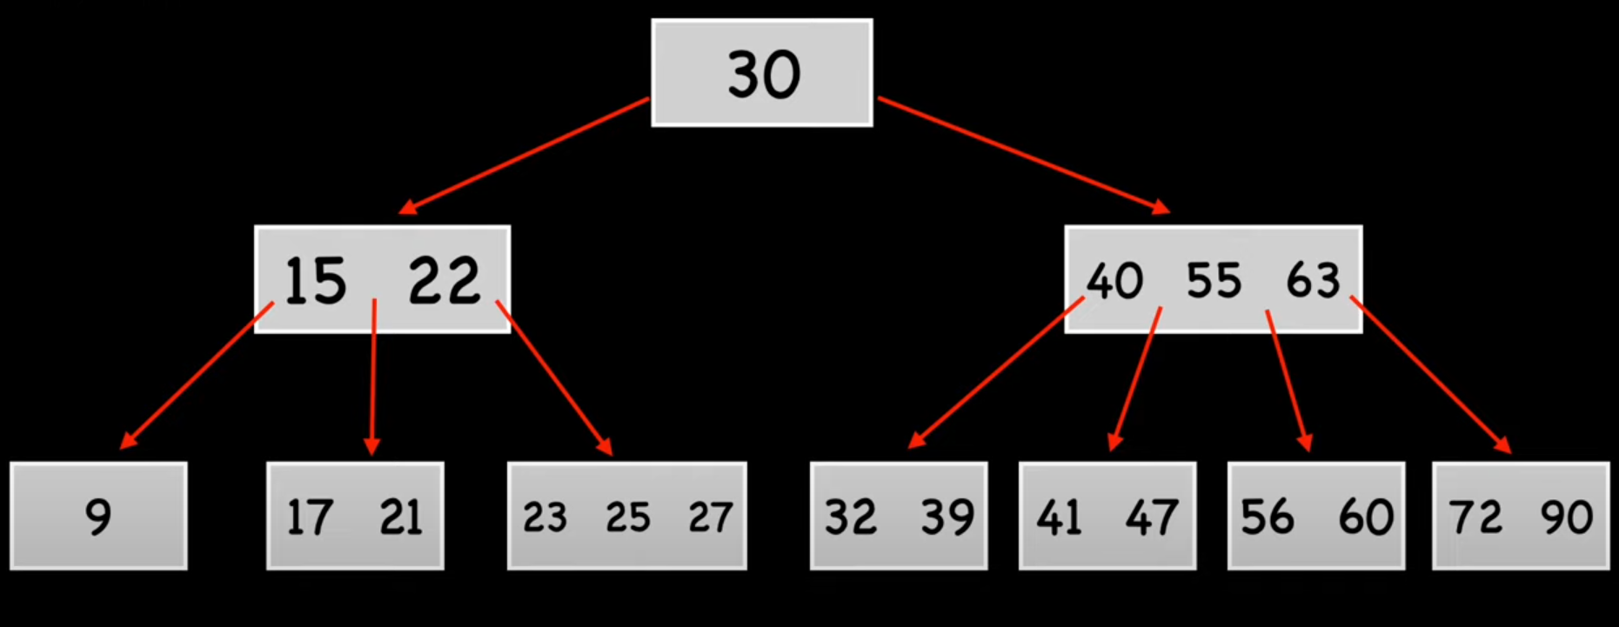

Slide 3
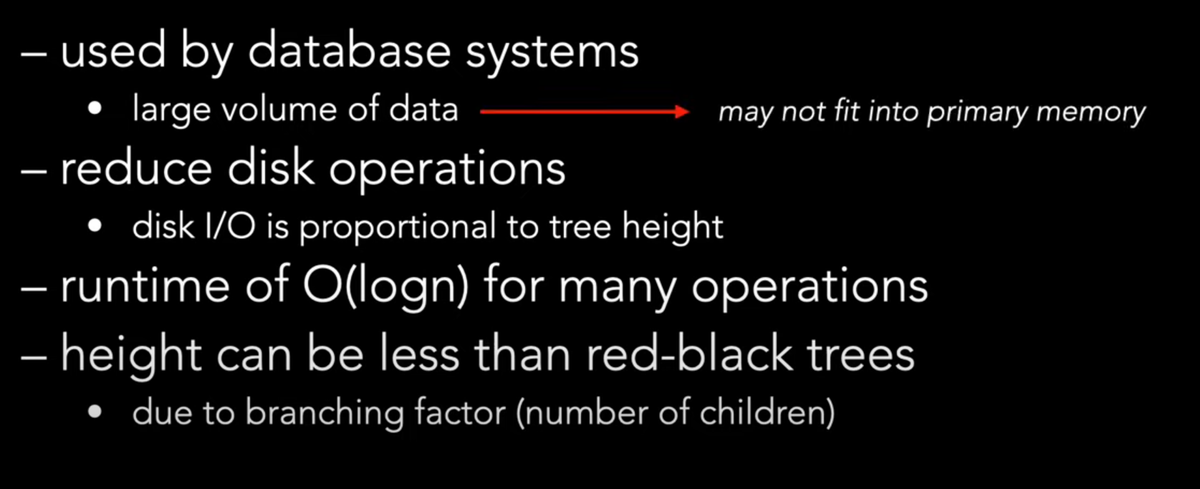

Slide 4
Properties of a B-tree:
Balanced Tree: All leaf nodes are at the same depth, ensuring that search, insertion, and deletion operations are performed in O(log n) time.
Multi-way Tree: Each node can have multiple children (more than two), which allows it to hold a large amount of data, reducing the tree's height.
Nodes: Internal nodes have multiple keys to direct the search down the tree. Leaf nodes contain the actual data.

